Slide 1
CSS Box Model

Slide 2
Objective
By the end of this part of the course, you will
Understand the box model in CSS
Learn how to set margins and paddings for your content
Learn how to use borders and backgrounds in your page
Resource
Chapter 4 – Fundamentals of Web Development.

Slide 3
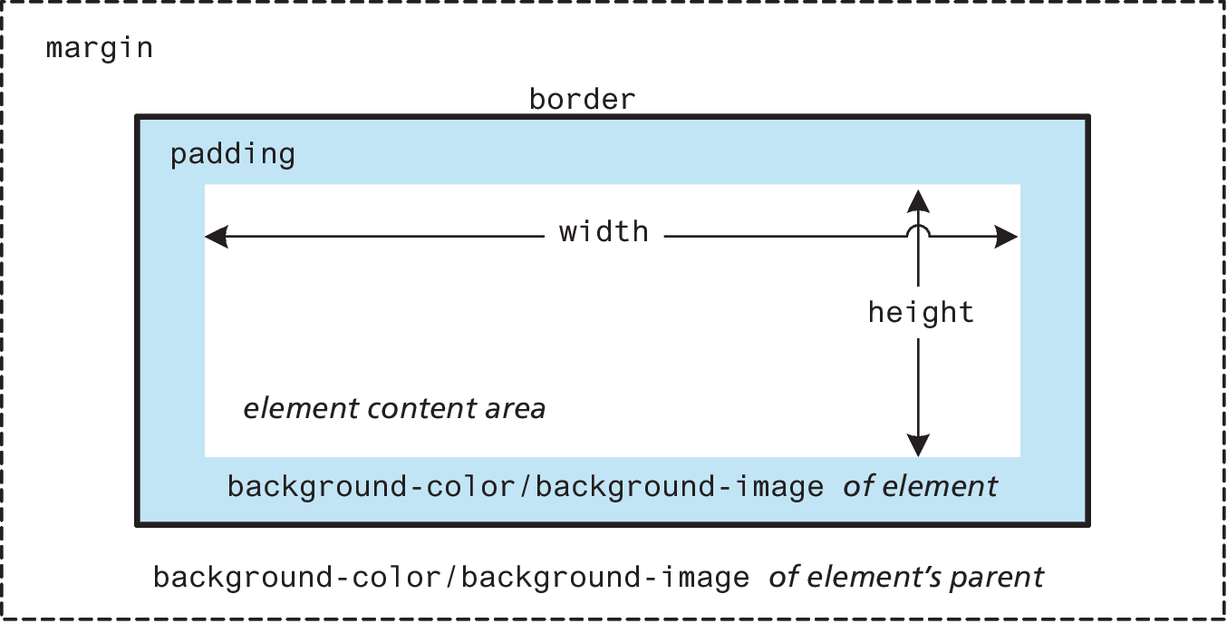
The Box Model
In CSS, all HTML elements exist within an element box. In order to become proficient with CSS, you must become familiar with the box model.

Slide 4
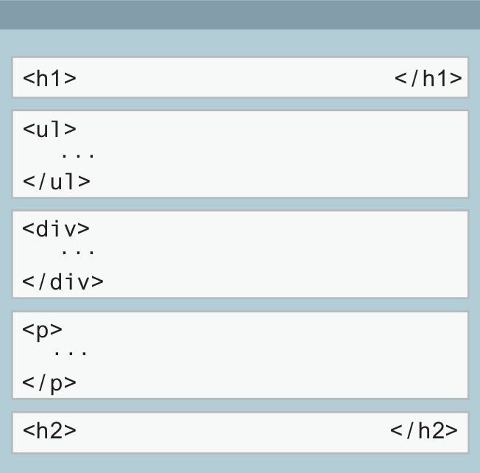
Block Elements
Block-level elements such as <p>, <div>, <h2>, <ul>, and <table> each occupy their own line.
without styling, two block-level elements can’t exist on the same line!
Block-level elements use the normal CSS box model

Slide 5
Inline Elements
Inline elements do not form their own blocks but instead are displayed within lines.
Normal text in an HTML document is inline, as are elements such as <em>, <a>, <img>, and <span>.
When there isn’t enough space left on the line, the content moves to a new line

Slide 6
Which are which?
Block elements
Inline elements
article
aside
blockquote
details
dd, dt, dl
div
fieldset
figcaption
figure
footer
header
h1, h2, etc.
hr
ol, ul, li
Dt, dd
main
nav
p
pre
section
table
...
a
b
big
br
button
cite
code
em
i
img
input
label
object
select
small
span
strong
sub
sup
time
...

Slide 7
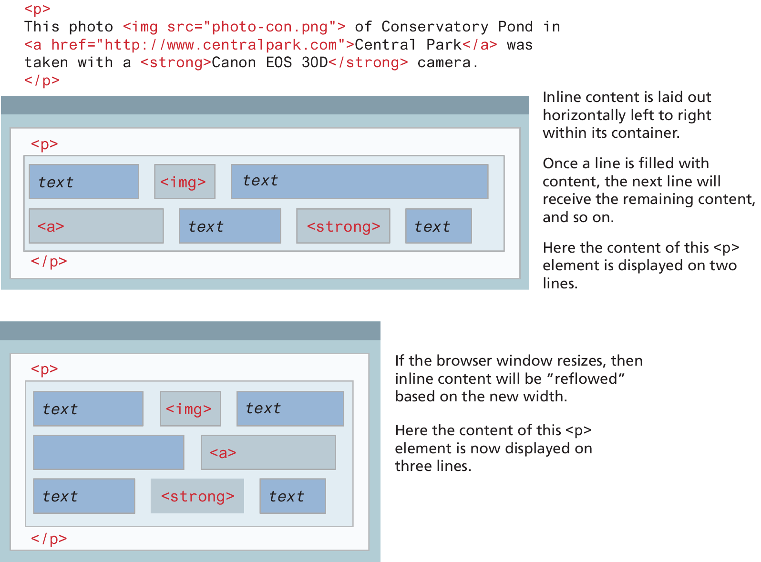
Inline Element Example

Slide 8
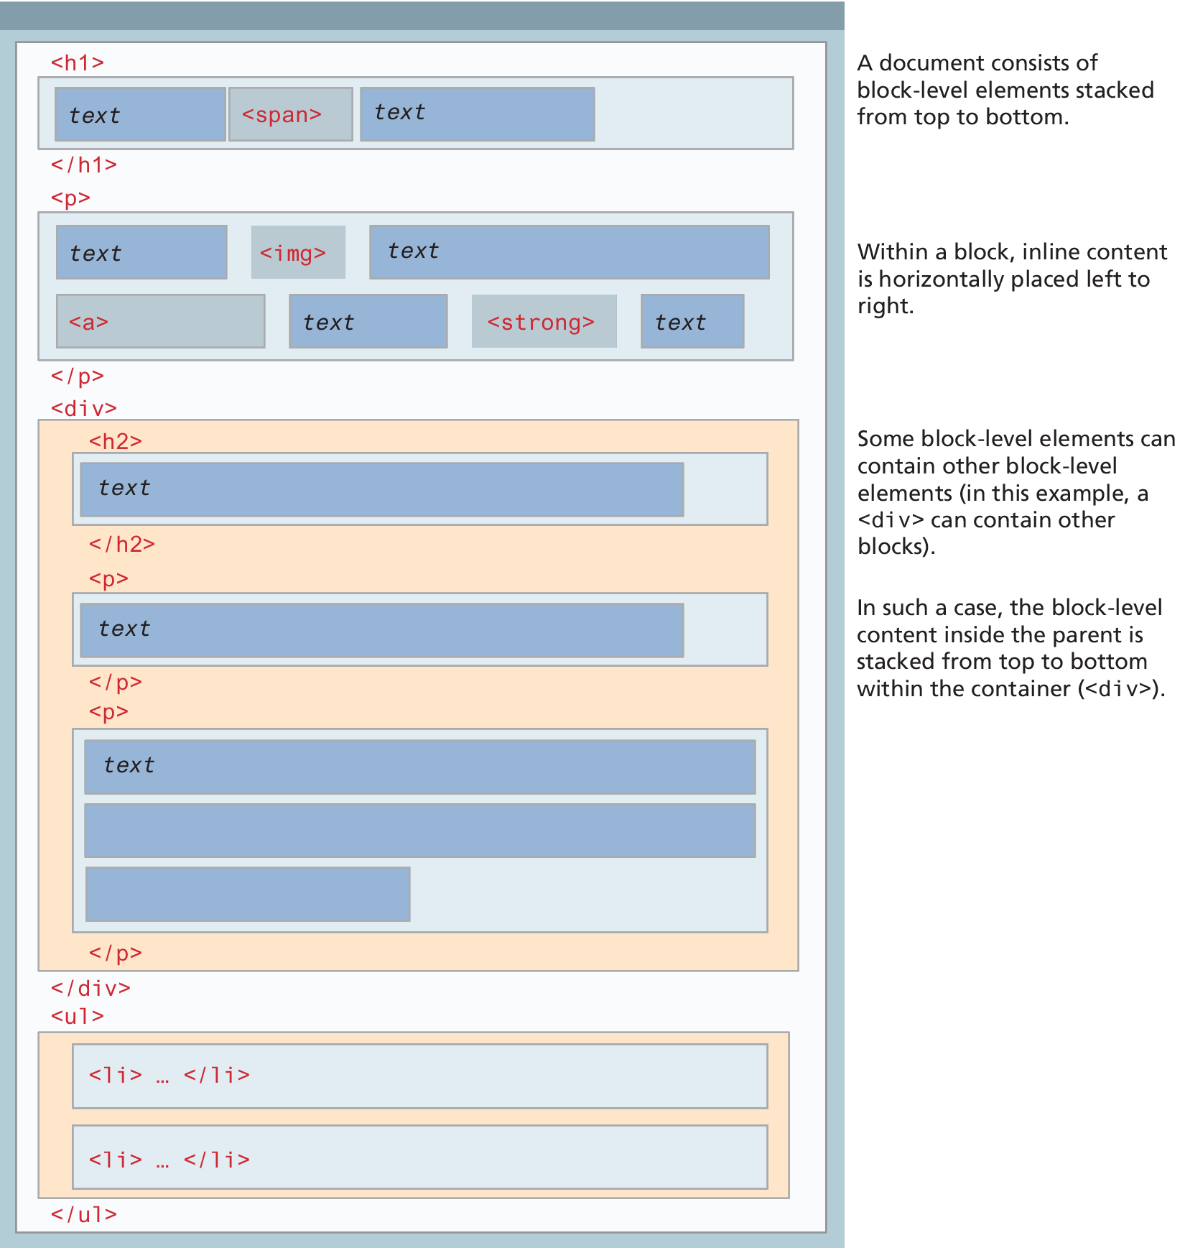
Block and inline elements together

Slide 9
Background
The background of an element fills an element out to its border
Background image properties include:
Background, background-attachment, background-color, background-image, background-origin, background-position, background-repeat, background-size
Some of these properties work together, others do not → Look them up or PLAY

Slide 10
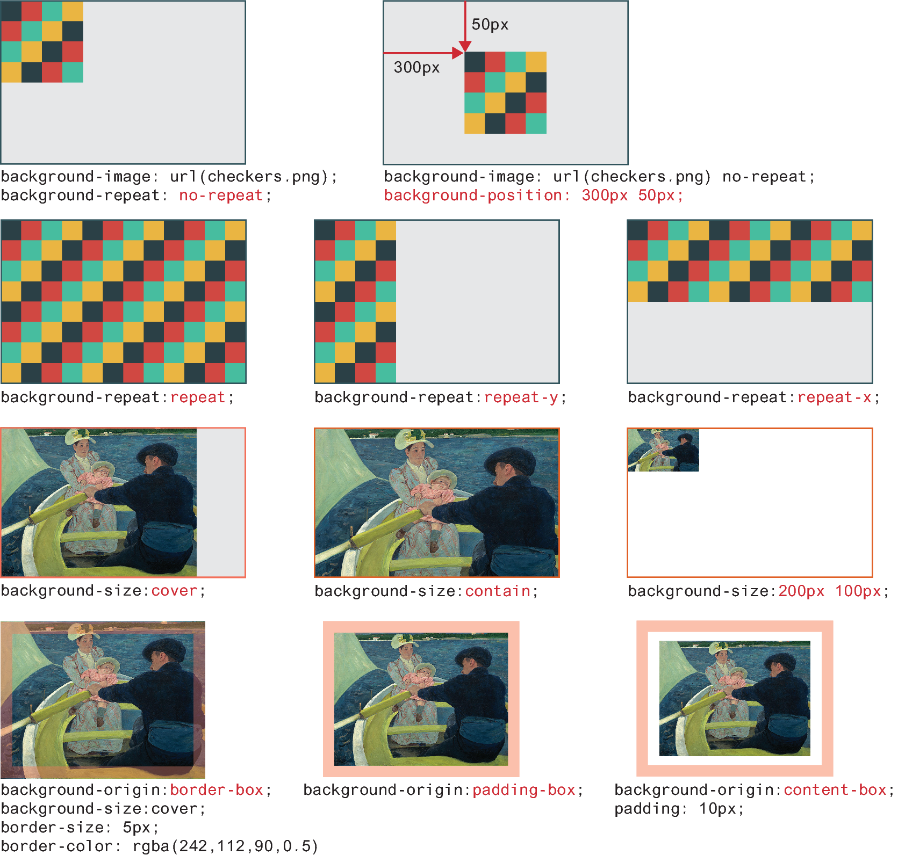
Background image examples

Slide 11
Borders
Borders provide a way to visually separate elements.
You can put borders around all four sides of an element, or just one, two, or three of the sides.
Border, border-style, border-width, border-color, border-radius, border-image

Slide 12
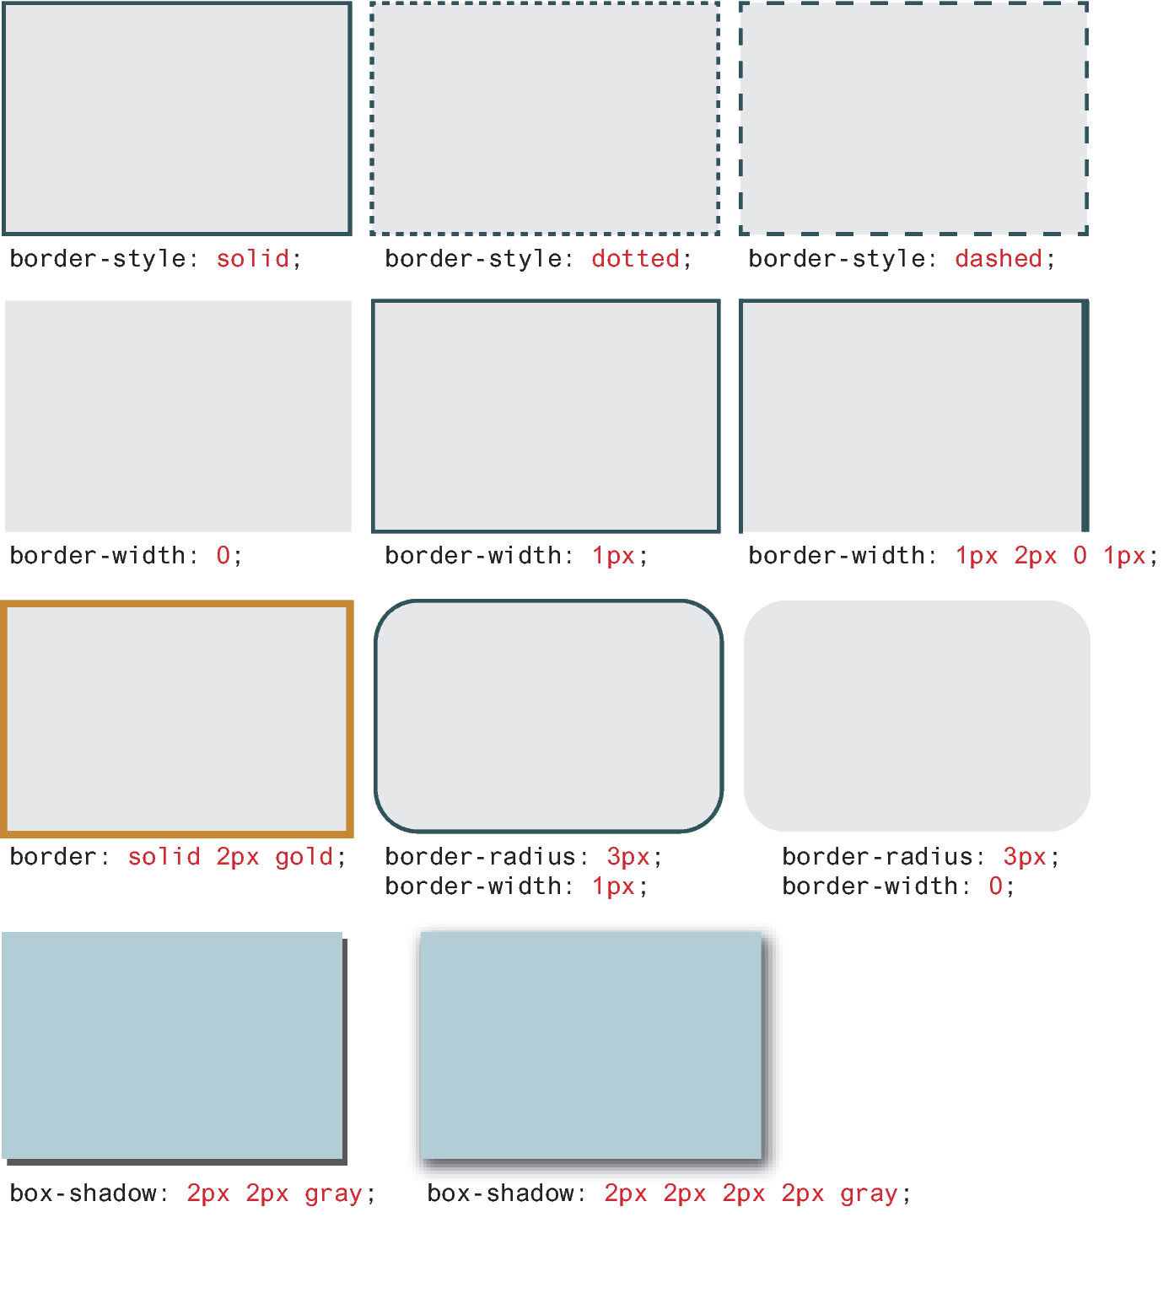
Border and Shadow Examples

Slide 13

Box Model: Setting the Properties
NOTE
With border, margin, and padding properties, it is possible to set the properties for
one or more sides in a single property, or individually
border-top-color: red; /* sets just the top side */
border-right-color: green; /* sets just the right side */
border-bottom-color: yellow; /* sets just the bottom side */
border-left-color: blue; /* sets just the left side */
Alternately, we can set all four sides to a single value via:
border-color: red; /* sets all four sides to red */
Or we can set all four sides to different values via:
border-color: red green orange blue;
Another shortcut is to use just two values; in this case the first value sets top and bottom, while the second sets the right and left.
border-color: red yellow; /* top+bottom=red, right+left=yellow */

Slide 14
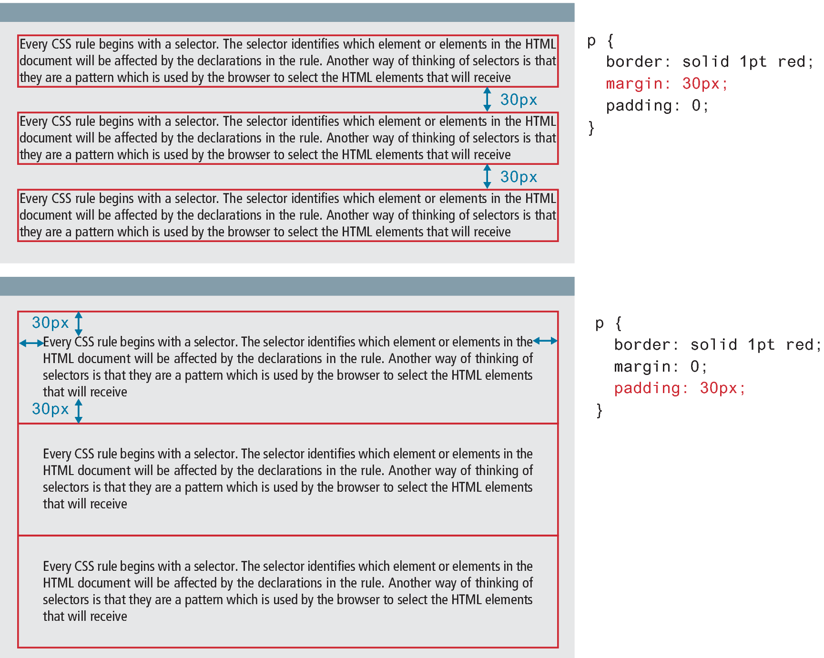
Margins and Padding
Margins add spacing around an element’s content
Padding adds spacing within elements.
Borders divide the margin area from the padding area.

Slide 15
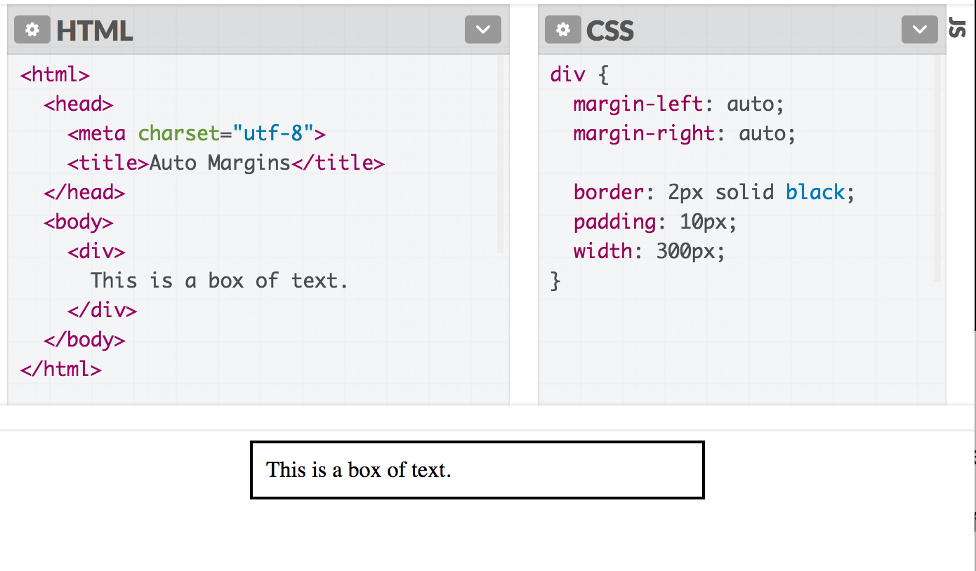
Auto Margins
If you set margin-left and margin-right to auto, you can center a block-level element.

Slide 16
Collapsing margins
The W3C defines collapsing margins as:
In CSS, the adjoining margins of two or more boxes (which might or might not be siblings) can combine to form a single margin. Margins that combine this way are said to collapse, and the resulting combined margin is called a collapsed margin.
What this means is that when the vertical margins of two elements touch, only the largest margin value of the elements will be displayed
Horizontal margins, on the other hand, never collapse.

Slide 17
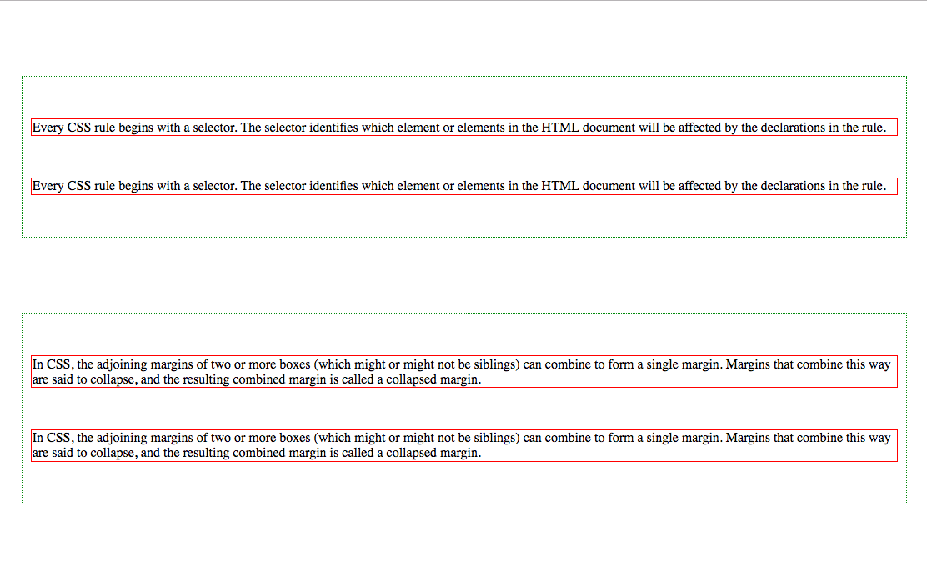
Collapsing vertical margins
div {
border: dotted 1pt green;
padding: 0;
margin: 90px 20px;
}
90px
50px
50px
50px
p {
border: solid 1pt red;
padding: 0;
margin: 50px 20px;
}
90px
90px

Slide 18
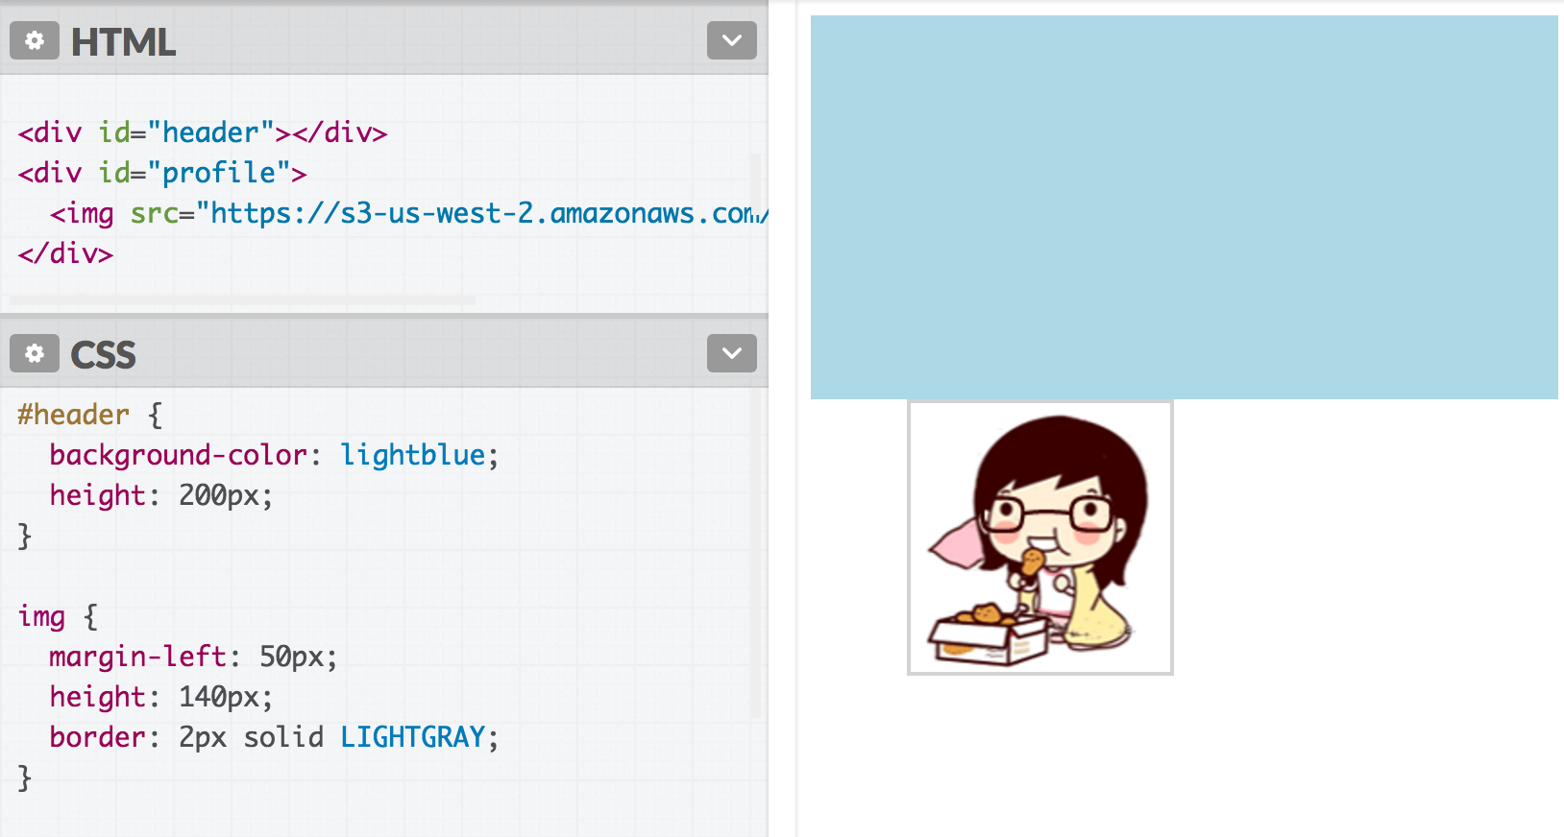
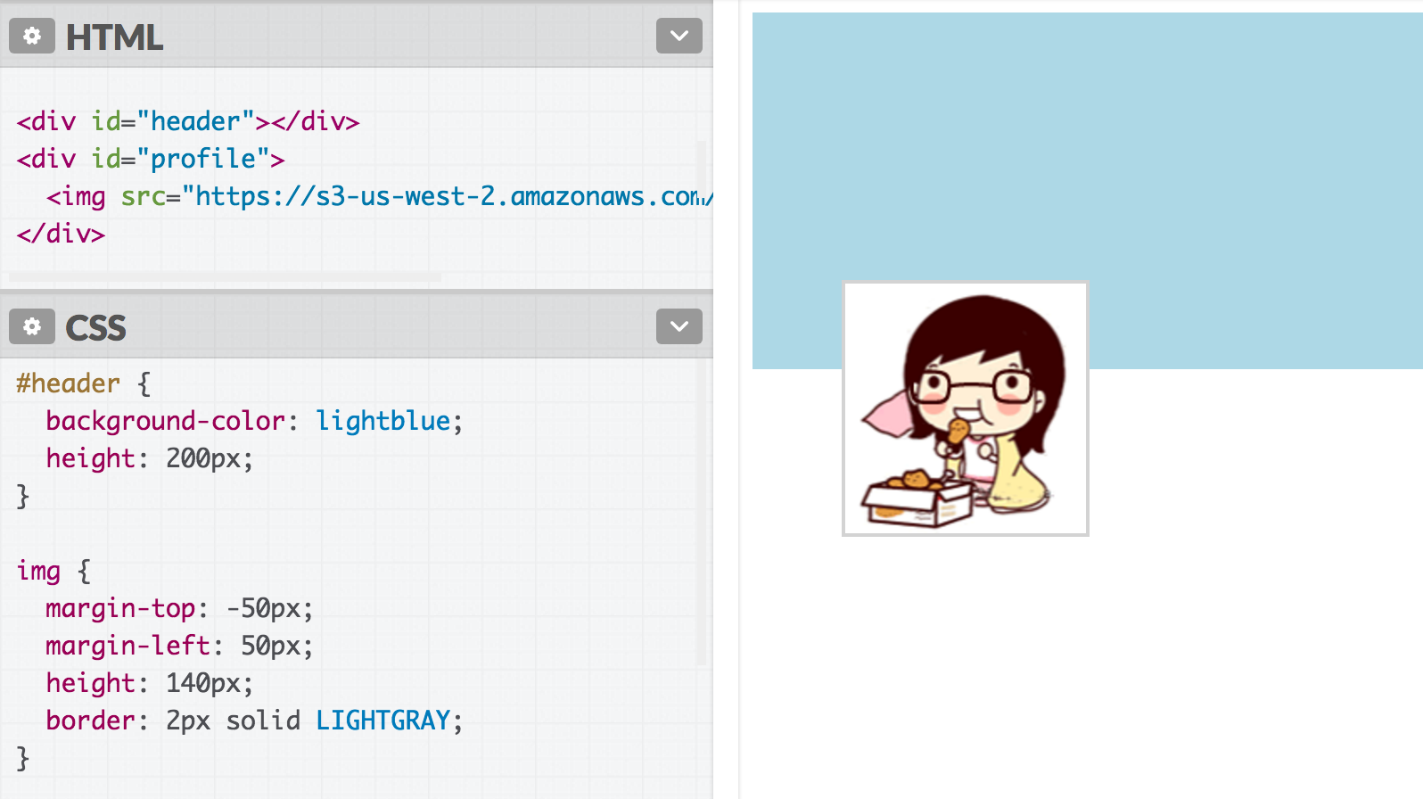
Negative Margin
Margins can be negative.
img { margin-top: -50px; }

Slide 19
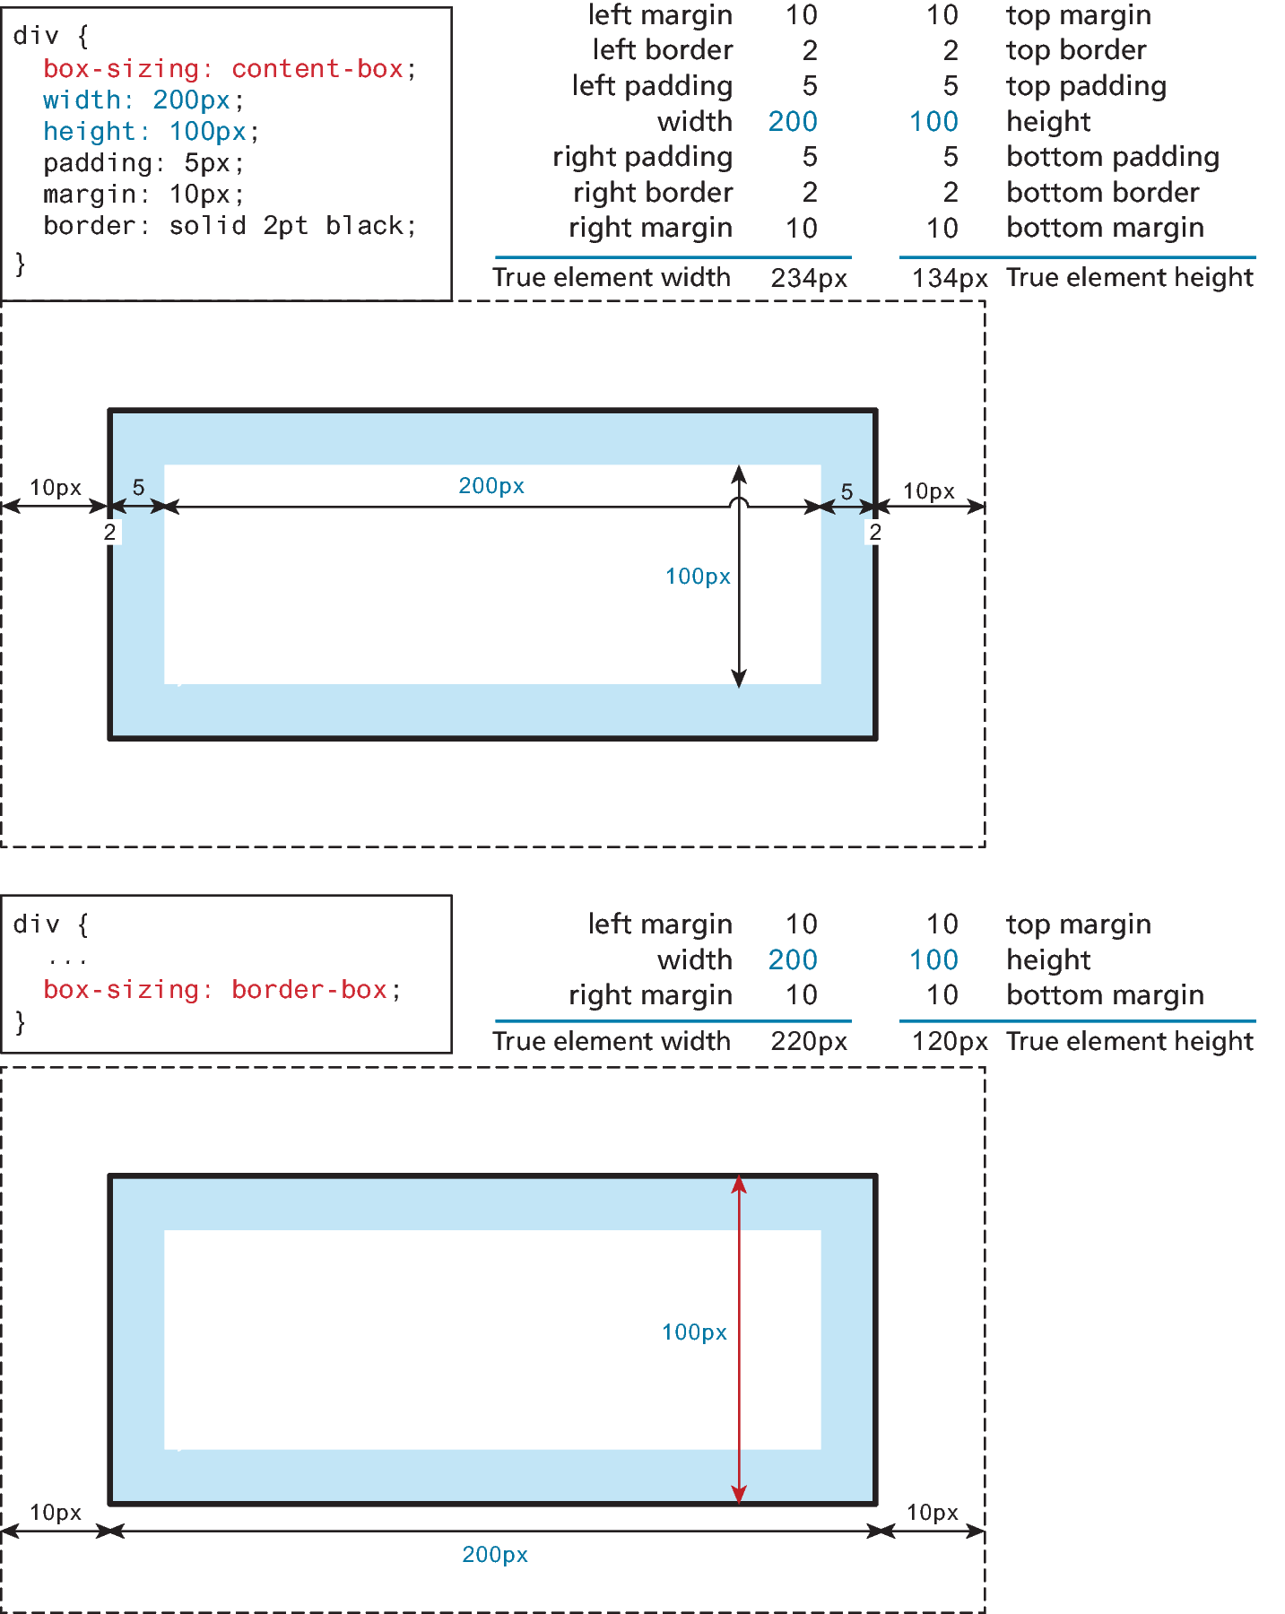
Box Dimensions
Block-level elements have width and height properties.
They also have a min-width, min-height, max-width, and max-height properties as well to help when the width or a height might be specified as a % of its parent container
Since the width and the height only refer to the size of the content area, the total size of an element is equal to the size of its content area plus the sum of its padding, borders, and margins.

Slide 20
The border-box approach
To reduce complexity of adding margins, content and borders, you can use the newer border-box approach that is more intuitive.
Setting the box-sizing as border-box tells the browser to account for any border and padding in the values you specify for an element's width and height.
Here, the div element’s width set to 200 px, which, using this approach, will shrink the ‘content box’ to absorb the 10 px margin (or padding) so that the entire element’s width ‘fits’ in the 200 px.
Note: More useful for absolute positioning and less useful with ‘relative’ positioning and sizing.

Slide 21
Limitation of Height Property

Slide 22
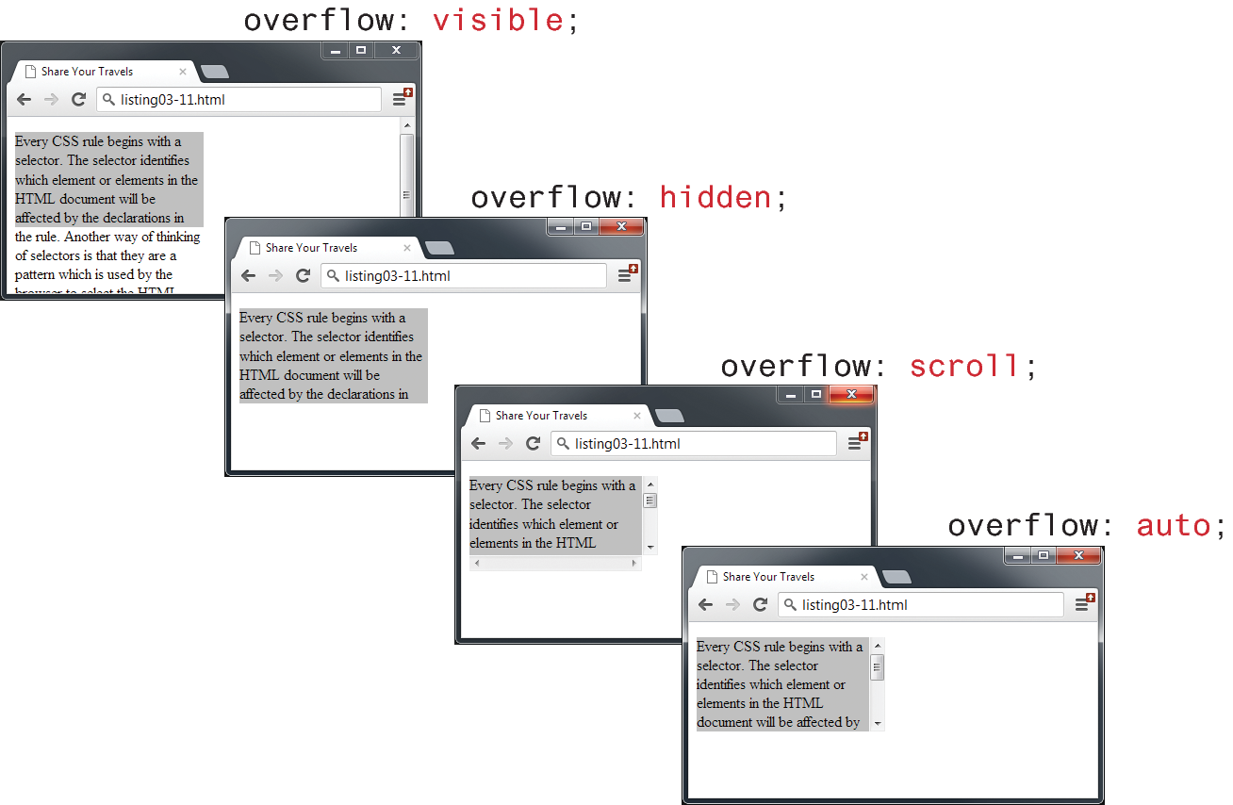
Overflow Property
It is possible to control what happens with the content if the box’s width and height are not large enough to display the content using the overflow property

Slide 23
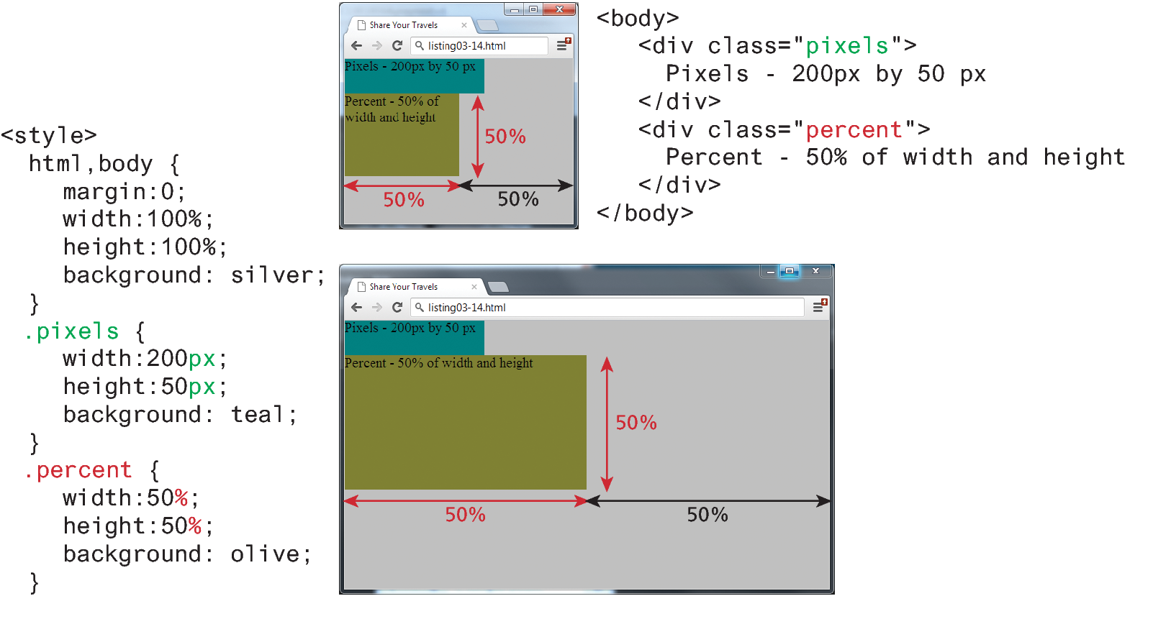
Box sizing via percent

Slide 24
Any Question?

